Slide 1



KONGU ENGINEERING COLLEGE
PERUNDURAI ERODE-638060
DEPARTMENT OF
ARTIFICIAL INTELLIGENCE
20ALP61–Project Work I
Enhancing Land Cover
Classification using Satellite Data
Team Mentor: Dr.K.S.Kalaivani
Assistant Professor (SrG)
Team Members: Mohamed Bilal Z H - 21ALR027
Dhanush M - 21ALR011
Gowtham M - 21ALR018

Slide 2
Problem Statement
The problem addressed in this study is the classification of bone fractures from X-ray images using machine learning
The accurate and timely classification of fractures is crucial for effective diagnosis and treatment planning in the field of orthopedics.
Traditional methods of fracture classification heavily rely on human expertise, which can be time-consuming and subjective.
Therefore, there is a need to develop a machine learning-based approach that can automate the fracture classification process, providing a reliable and efficient solution.

Slide 3

Introduction
The Capuchin bird, known for its distinctive and melodious calls, holds a special place. However, the dense and often inaccessible habitats that these birds have make traditional visual observation challenging, so using audio for finding its habitat is a efficient choice.
In this situation we use Deep Learning to build a model to identify the capuchin bird calls using audio, this helps us to conform the presence of the Capuchin bird.
Upon identifying the presence of that bird we can find the particular habitats of the Capuchin and mark that particular places to preserve the bird species.

Slide 4
Literature Survey
S.NO | TITLE OF THE PAPER | NAME OF THE AUTHORS | ALGORITHM USED
1. | GLCM Based Feature Extraction and Medical XRAY Image Classification using Machine Learning Techniques | Pawan Kumar Mall Department of Computer Science & Engineering Madan Mohan Malaviya University. | LBF SVM, Linear SVM, logistic regression and decision tree.
2. | Machine learning framework for image classification | Loussaief, Sehla, and Afef Abdelkrim | KNN, SVM, SURF
3. | Research on medical image classification using machine learning. | Hai Tang and Zhihui Hu School of Electrical and Information Engineering. China. | CNN, RBF-SVM, PCA-CNN, CNN-SVM.
4. | Comparative analysis of image classification algorithms based on traditional machine learning and deep learning | Wang, Pin, En Fan, and Peng Wang | Support Vector Machine, CNN, Deep Learning

Slide 5
Existing System
The Capuchin bird, known for its distinctive and melodious calls, holds a special place. However, the dense and often inaccessible habitats that these birds have make traditional visual observation challenging, so using audio for finding its habitat is a efficient choice.
In this situation we use Deep Learning to build a model to identify the capuchin bird calls using audio, this helps us to conform the presence of the Capuchin bird.
Upon identifying the presence of that bird we can find the particular habitats of the Capuchin and mark that particular places to preserve the bird species.

Slide 6
Proposed Work
Algorithms
U-Net++
DeepLabV3
UNet 3+
DeepLabV3+
BiSeNet (Bilateral Segmentation Network)
Dataset
The dataset that has been utilized is available from Kaggle.
There are 7 classes in the dataset urban_land, agriculture_land, rangeland, forest_land, water, barren_land, unknown.

Slide 7
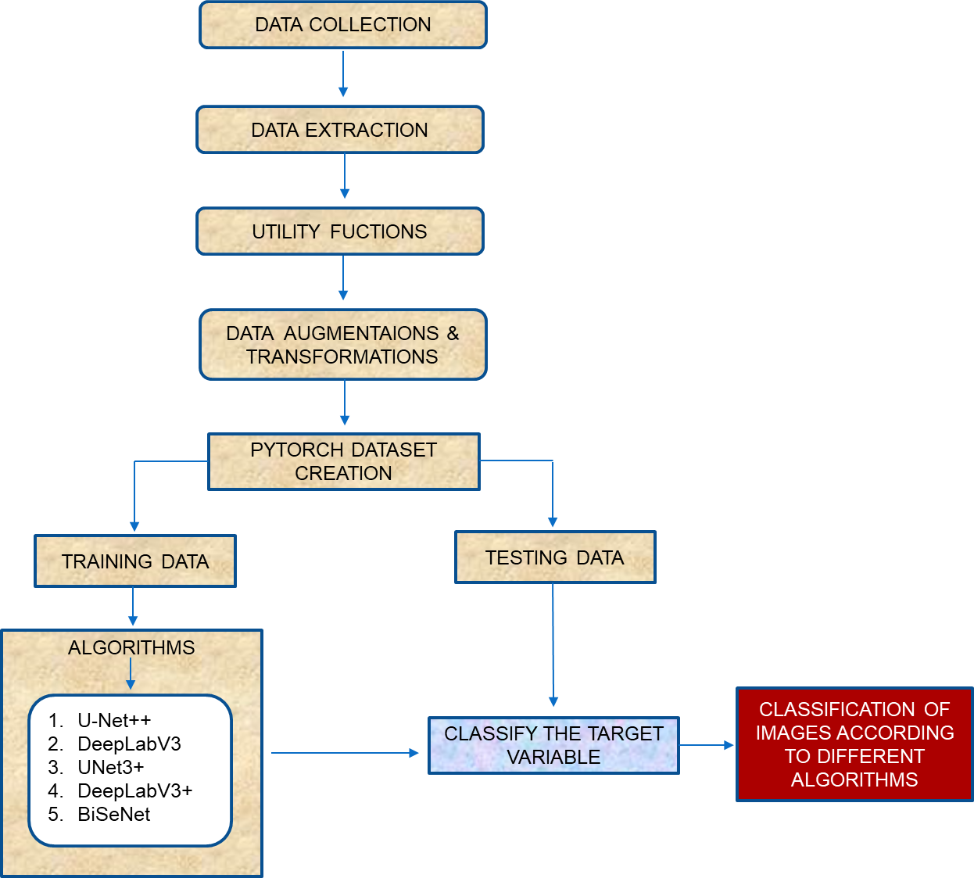
a. Proposed Model
Metrics
Confusion Matrix
Classification Report
IoU (Intersection over Union)
AUC-ROC Graph

Slide 8
References
1. Jagannathan, J., and C. Divya. "Deep learning for the prediction and classification of land use and land cover changes using deep convolutional neural network." Ecological Informatics 65 (2021): 101412.
2. Lu, Dengsheng, et al. "Land use/cover classification in the Brazilian Amazon using satellite images." Pesquisa agropecuária brasileira 47 (2012): 1185-1208.
3. Bocco, Mónica, et al. "Neural network models for land cover classification from satellite images." Agricultura técnica 67.4 (2007): 414-421.
4. Manandhar, Ramita, Inakwu OA Odeh, and Tiho Ancev. "Improving the accuracy of land use and land cover classification of Landsat data using post-classification enhancement." Remote Sensing 1.3 (2009): 330-344.
5. Gudmann, András, et al. "Improvement in satellite image-based land cover classification with landscape metrics." Remote Sensing 12.21 (2020): 3580.

